Slide 1
Skookum IT Solutions
Shaun Bennett, Christian Calhoun, Dante De La Riva, Kincaid Young

Slide 2



Shaun Bennett: VP of Consulting
Kincaid Young: VP of Advertising
Dante De La Riva: Lead Product Designer
Christian Calhoun: Lead Product Tester

Slide 3

Skookum IT Solutions
Small business with 50 years of combined experience
Have worked on several similar solutions for other small businesses
We’ll do our best to provide you with the best IT solutions for your needs

Slide 4

Co-founder of Airbnb

Slide 5
Agenda
Summary of requirements
Christian Calhoun- Summary of Billing
Shaun Bennett - Summary of Document Transfer
Kincaid Young - Summary of Advertisement
Dante De La Riva - Summary of Cost and Timeline
Notes:
Talk bou tht enext steps. What will be in the presentation.

Slide 6
Solution Goal
Faster Spread Of The Knowledge Of Tax Boss And Its Services To New Clientele.
Secure Transfer Of Sensitive Documents Between Tax Boss And Its Clientele.
An Automated System To Track Time Spent And Bill Clients For This Time.
A System Allowing Clients To Schedule Meetings With Tax Boss.
A Notification System Alerting Tax Boss To Upcoming Events, Such As Meetings.

Slide 7

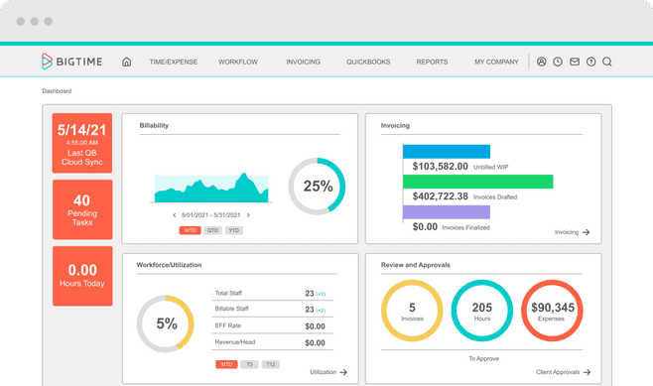
Track and Bill expenses and Time
Custom Invoices
Manage projects and budgets
Integrates with Google
Meeting schedule automatically added to the calendar
Notes:
Breiefly mention that google is a solution that shaun will be cover.

Slide 8

Google Workspace
Safe Transfer of Files
Creation of forms
Google Drive
Business Email

Slide 9
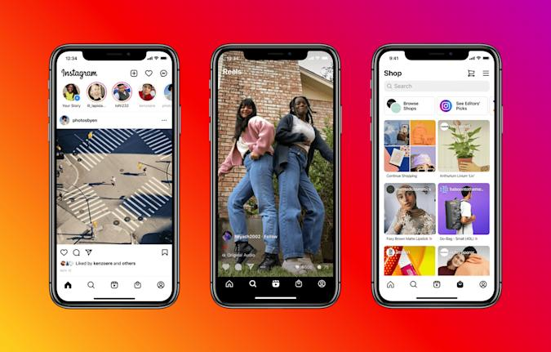
Advertising- Meta For Business
Facebook -
Larger audience (70% of adults are on Facebook
Better targets audience
Less expensive ads
Instagram –
More personal
Multiple ways to advertise (Regular posts, videos, stories etc.)

Slide 10
Cost
External Cost | Purpose | Price Year 1 | Price Year 2 | Price Year 3
Google Workspace | Document Transfer | $144 | $144 | $144
BigTime (Pro) | Time Keeping, Billing, Notifications | $1,800 | $1,800 | $1,800
Shookum | Advertisement Creation | $3,000 | $2,000 | $2,000
Meta Advertising | Advertisement Display | $2,000 | $2,000 | $2,000
Internal Cost
Training | Training in Solutions Above | $1,000 | $0 | $0
Total |  | $7,944 | $5,944 | $5,944

Slide 11
Timeline
 | Week 1 | Week 2 | Week 3 | Week 4 | Week 5
Google Workspace
BigTime
Shookum
Meta Advertising
Implementation
Training
Testing

Slide 13
Conclusion
Google Workspace provides a great experience for transferring sensitive documents between businesses and clients.
BigTime allows easy time management, billing, and notifications.
Meta Advertising allows fast and simple methods for advertising to Instagram and Facebook.
We, Shookum, will give our best to deliver great quality advertising.
We’re ready to take the next steps when you are!

